Slide 1
Set Operations
Chapter 2

Slide 2
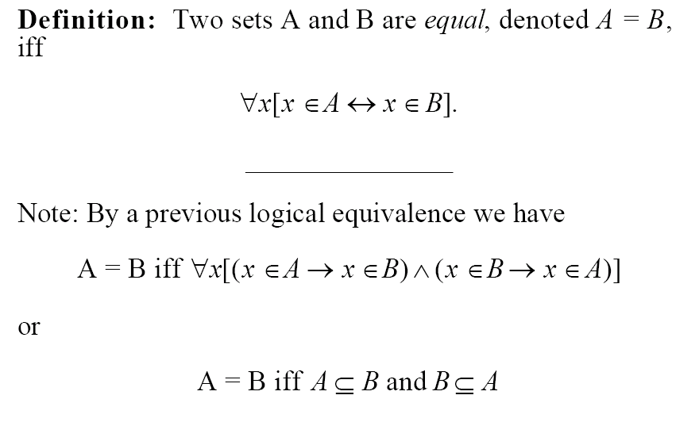
Equality

Slide 3
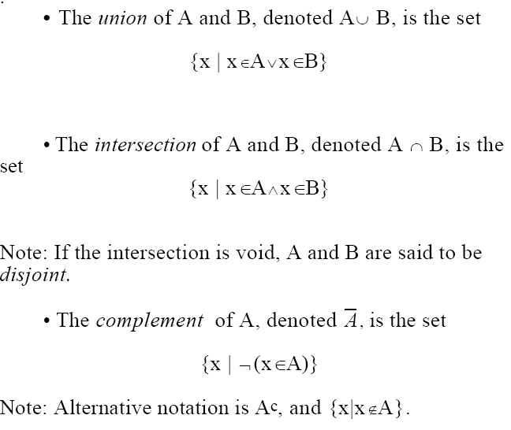
Definitions

Slide 4
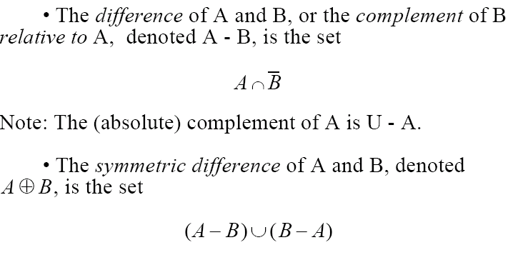
More Definitions
The (absolute) complement of B is U – B

Slide 5
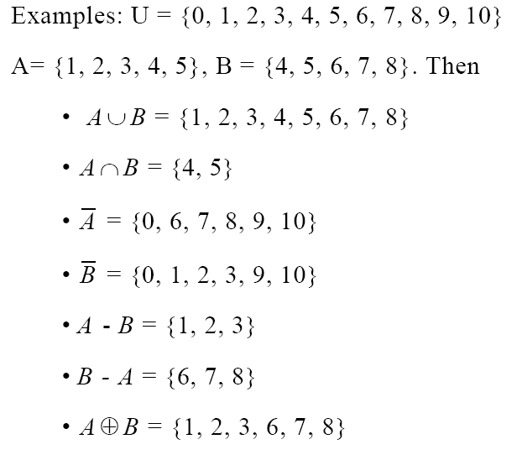
Example

Slide 6
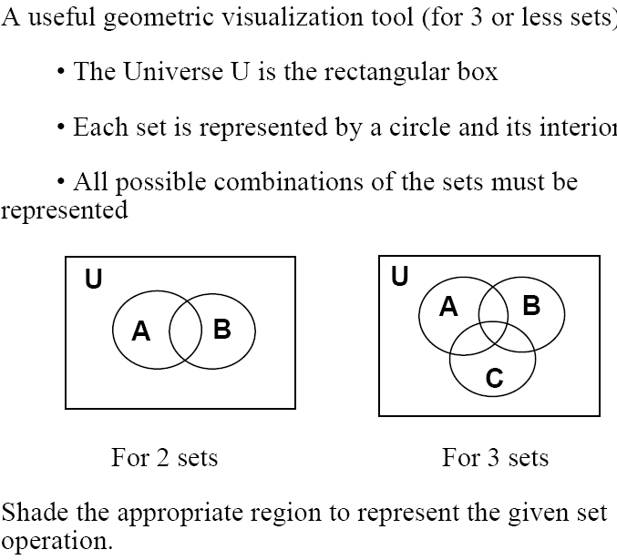
Venn Diagrams

Slide 7
Venn Diagrams Examples
What about intersection?

Slide 8
Venn Diagrams Examples
What about complement?

Slide 9
Venn Diagrams Examples
What about set difference?

Slide 10
Venn Diagrams Examples
What about symmetric difference?

Slide 11
Venn Diagrams Examples
Can you express symmetric difference using only union, intersection, and complement?

Slide 12
Set Identities
Identity | Name
 | Identity Laws
 | Domination Laws
 | Idempotent Laws
 | Complement Laws
 | Commutative Laws

Slide 13
some more …
Identity | Name
 | Associative laws
 | Distributive laws
 | DeMorgan’s laws
 | Absorption laws
 | Complement laws

Slide 14
How to prove set identities?
Several methods:
Use basic definition of sets, and apply logic
Use existing set identities
Use set table membership

Slide 15
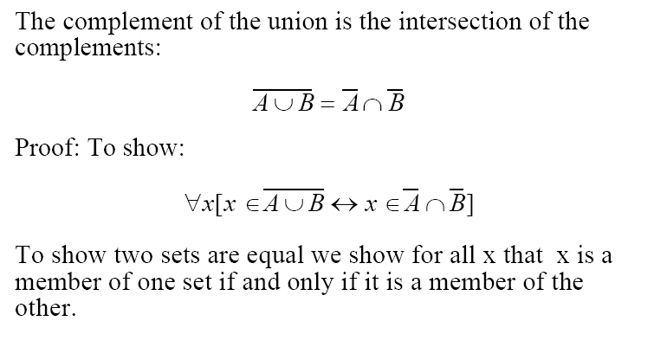
Example with definitions and logic

Slide 16
continued…
We will use “universal generalization”
We will perform our proof of P(x) using an “arbitrary” x
Since we did not assume anything specific about x, we can then conclude that
∀x P(x)

Slide 17
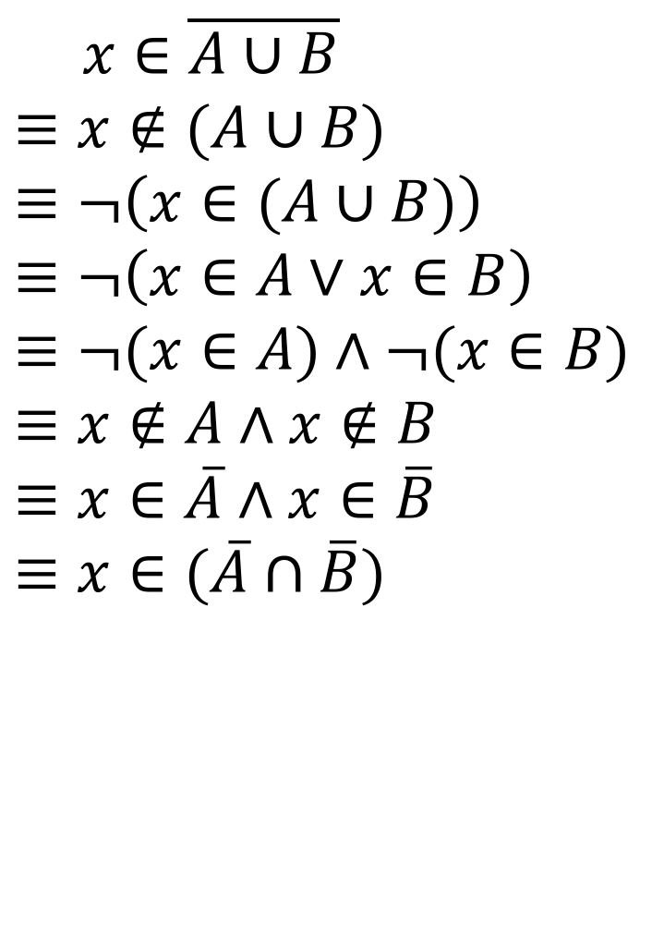
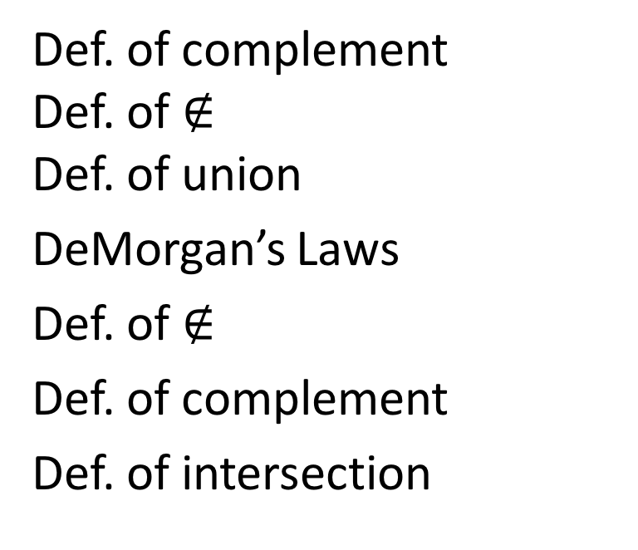
$$x∈\overline{A∪B} \\ ≡x∉(A∪B)$$
$$≡¬\left(x∈(A∪B)\right) \\ ≡¬\left(x∈A∨x∈B\right) \\ ≡¬(x∈A)∧¬(x∈B) \\ ≡x∉A∧x∉B \\ ≡x∈\overline{A}∧x∈\overline{B} \\ ≡x∈(\overline{A}∩\overline{B})$$
Def. of complement Def. of $∉$ Def. of union
DeMorgan’s Laws
Def. of $∉$
Def. of complement
Def. of intersection

Slide 18
Example using set identities
Show that A – B =
De Morgan’s laws
= Distributive Rule
= Complement Law
= Identity Law
= Definition of difference
=

Slide 19
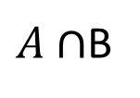
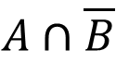
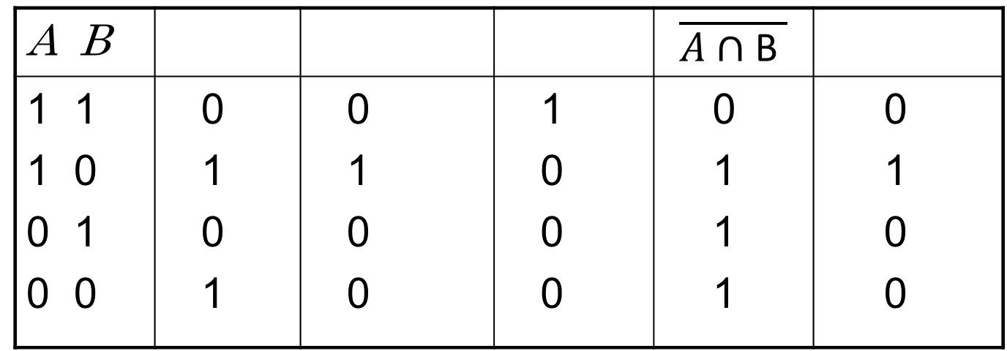
Example using a Set Membership Table
A B |  |  |  | $$\overline{A∩\text{B} }$$
1 1 1 0 0 1 0 0 | 0 1 0 1 | 0 1 0 0 | 1 0 0 0 | 0 1 1 1 | 0 1 0 0
$$A∩\overline{B}$$
$A∩$B

Slide 20
Efficient Computer Representation
Assume that the universal set U is finite and a reasonable size n.
Order the set.
Represent a subset A of theU to be the bit string of length n which has a 1 in the i^{th} position if the i^{th} element in the ordering is in set A and a 0 otherwise.

Slide 21
Example
U = {1,2,3,4,5,6,7,8,9,10} be ordered in the usual fashion.
The set S = {1,5,8}
Has the representation
1000100100

Slide 22
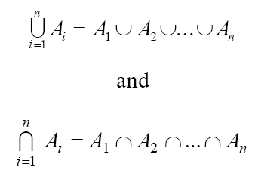
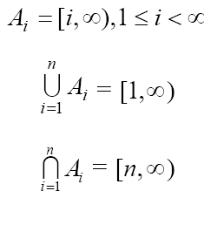
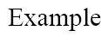
Union and Intersection of Indexed Collections

Slide 23
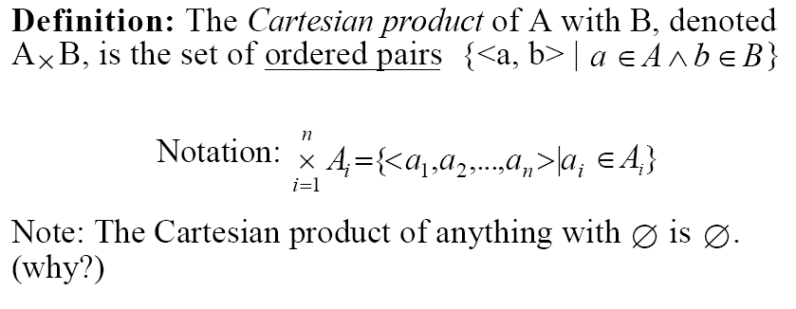
Cartesian

Slide 24
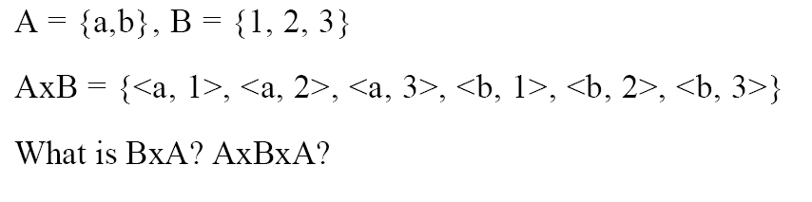
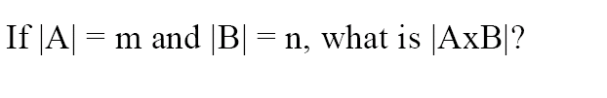
Example

